Slide 1



Slide 2
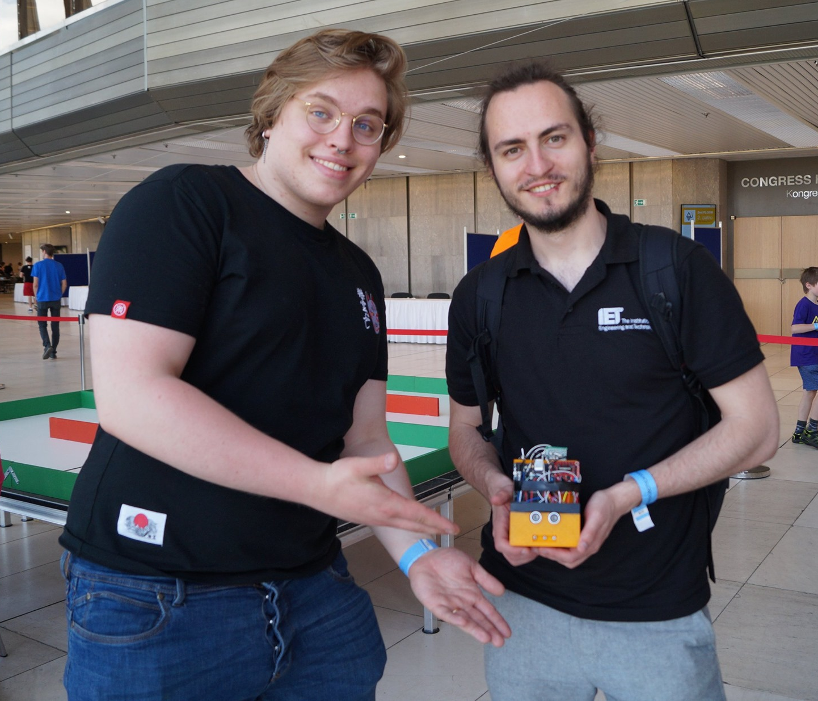
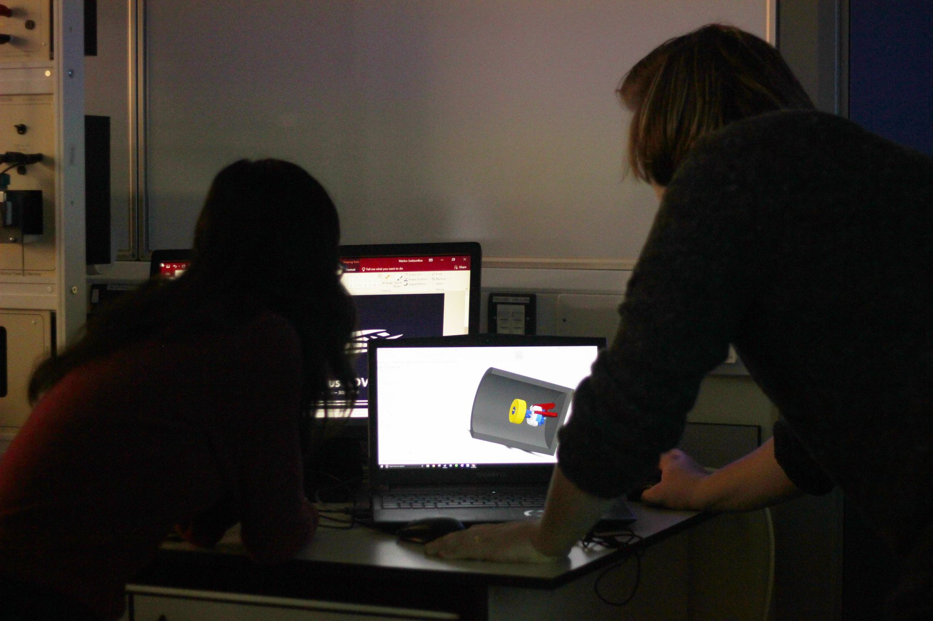
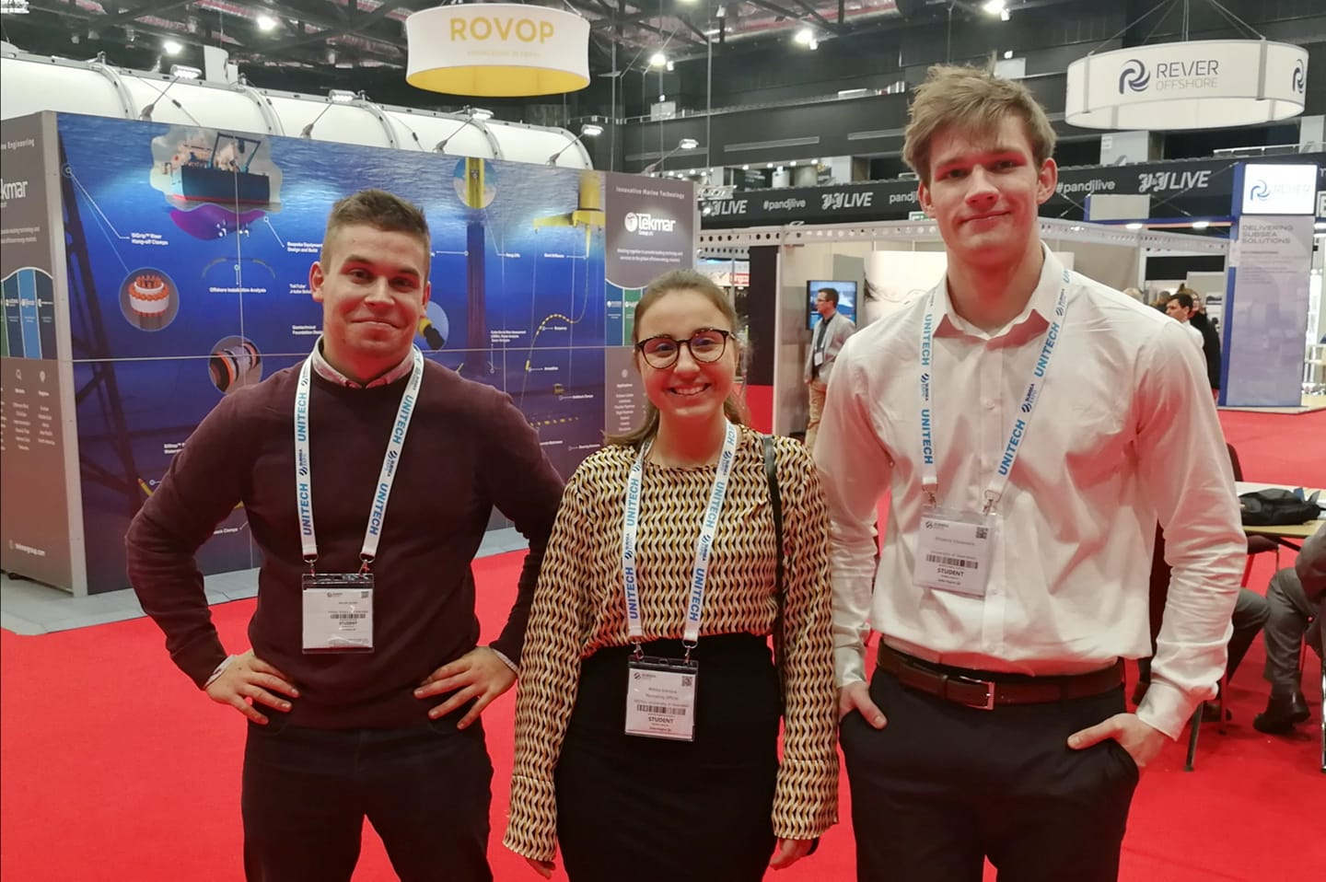
Who Are We?
Community of students from across all years of study with a common interest and passion for engineering
Students from EEE, other engineering disciplines as well as other schools

Slide 3
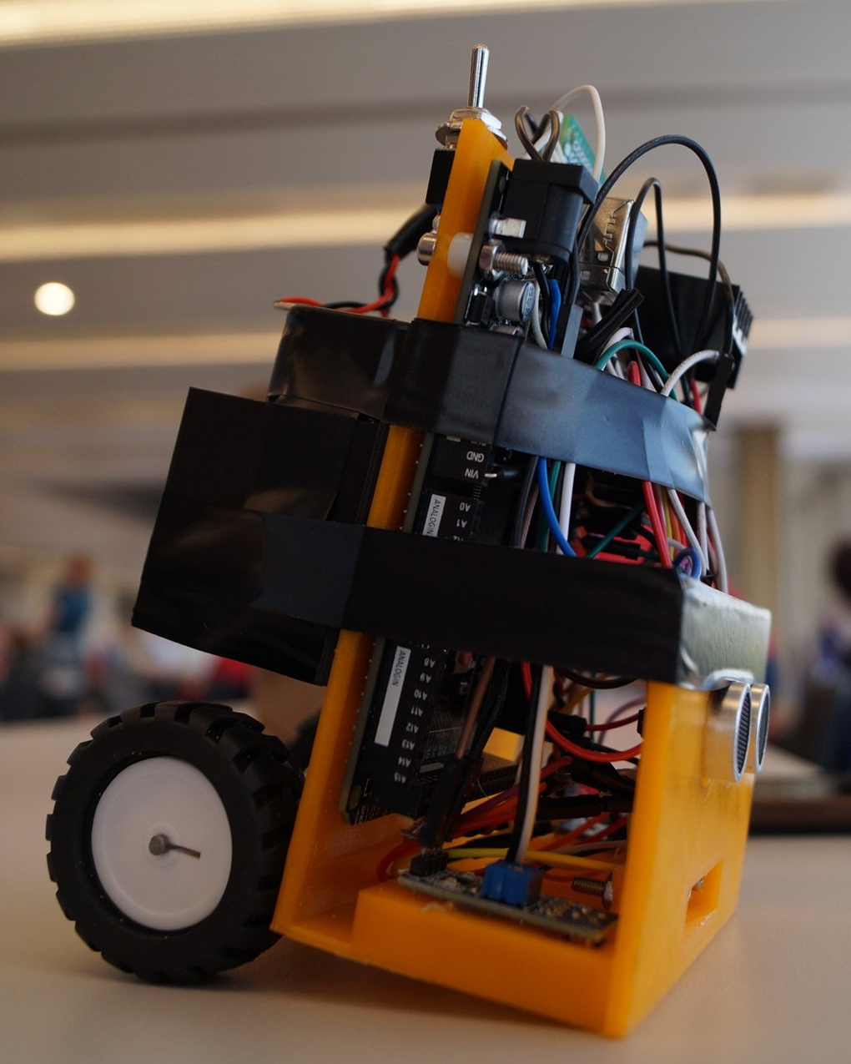
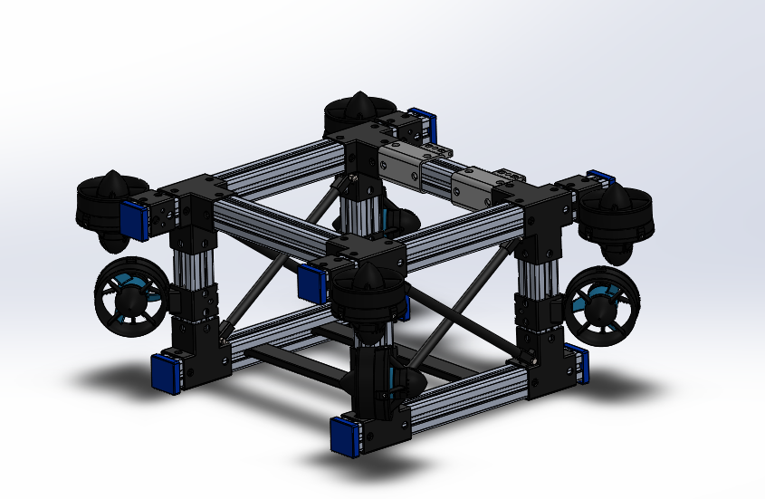
What Do We Do?
  Practical projects and engineering competitions
    Robot Sumo
    MATE ROV (Nautilus ROV team)
  Workshops
    Electronics 101
    University open days
  Social events

Slide 4
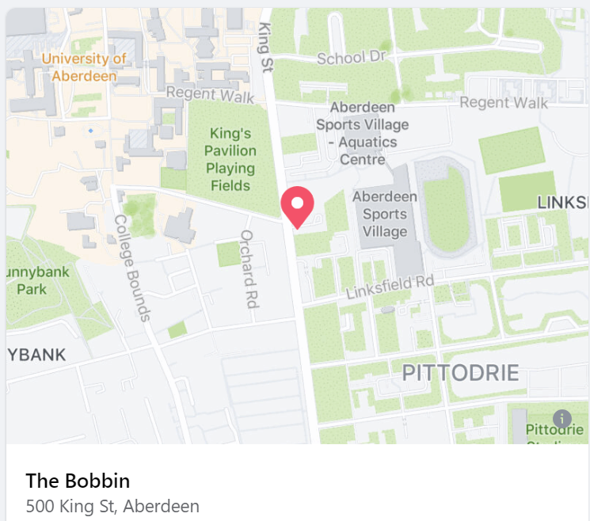
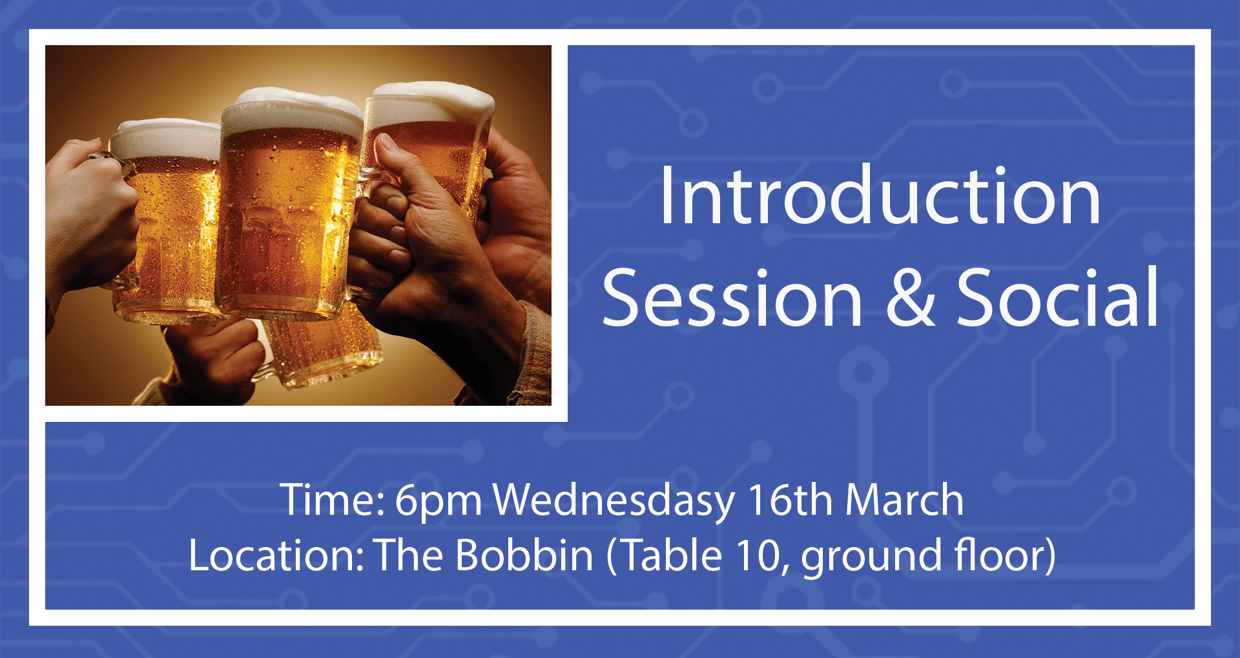
First Information Session
16th March, 6pm at The Bobbin
Come along if you are interested in getting involved or just finding out more about EEESoc

Slide 5
Where To Find Us?
Facebook: https://www.facebook.com/EEESocAbdn
AUSA: https://www.ausa.org.uk/organisation/21981/
Email: eee@ausa.org.uk
Thank you for your attention! Hope to see you at our first event of the year!

